Slide 1
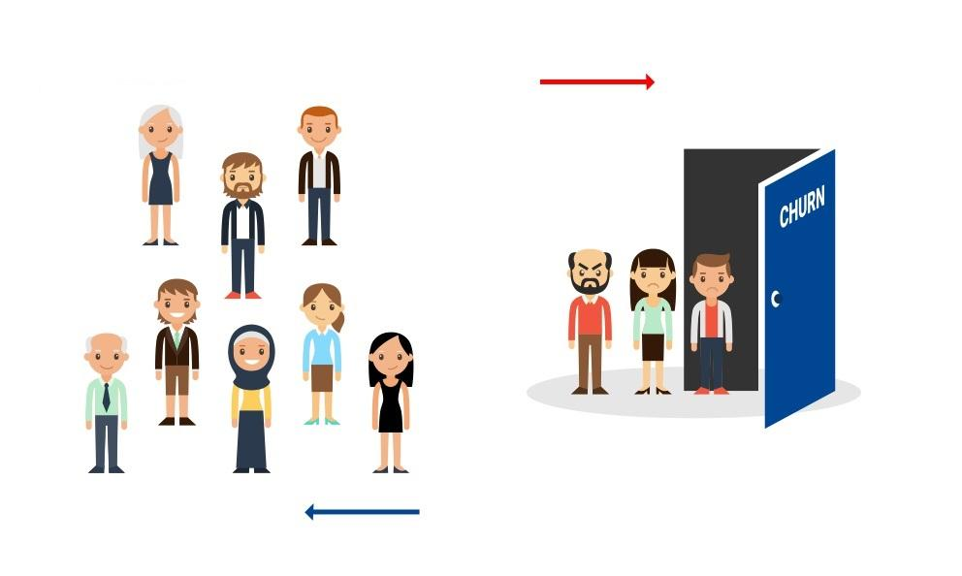
Predicting Customer Churn using Logistic Regression and Random Forest

Slide 2



Final project presentation
BIA 652-B
(MULTIVARIATE DATA ANALYSIS)
Under the guidance of Prof. Khasha Dehnad
Presented By:
Ameya Swar Suguna Bontha Rashmi Khurana Rushabh Vakharia

Slide 3
Objectives/Business needs
Customer churn has become one of the top issues for most banks.
It costs significantly more to acquire new customers than it costs to retain existing ones, and it costs far more to re-acquire defected customers.
In fact, several empirical studies and models have proven than churn remains one of the biggest destructors of enterprise value for banks and other customer intensive companies.
Churn is important because it directly affects the organization’s profitability and it is common to assume that the profitability of a service is directly related to the growth of its customer base.
Using the available information in the dataset, we have used logistic regression and random forest to predict which customers are most likely to exit the bank in the near future.

Slide 4
Dataset Source and Variables
The dataset was obtained from Kaggle and it had a total of 11458 records.
The dataset was divided into a training dataset (10000 records) and a test dataset (1000 records).
The remaining 458 records had to be removed since they either contained missing values or were duplicates.
The dataset had a total of 14 variables/features.
The dependent variable is “Exited”.

Slide 5
Dataset Source and Variables
The list of variables is as follows:
RowNumber (Numerical)
CustomerId (Numerical)
Surname (Categorical)
CreditScore (Discrete Numerical)
Geography (Categorical)
Gender (Binary Categorical)
Age (Discrete Numerical)
Tenure (Discrete Numerical)
Balance (Continuous Numerical)
NumOfProducts (Discrete Numerical)
HasCrCard (Binary Categorical)
IsActiveMember (Binary Categorical)
EstimatedSalary (Continuous Numerical)
Exited (Binary Categorical)

Slide 6
Tools Used for Analysis
Multiple tools were used for the analysis.
The dataset was initially in a .csv format and we used MS Excel to process the same.
SSIS (SQL Server Integration Services) was used for the ETL (data pre-processing) stage.
We made use of Tableau for creating visualizations, dashboards, and storyline.
SAS and R were used for data modeling.
We even used GRETL to do the prediction of data.

Slide 7
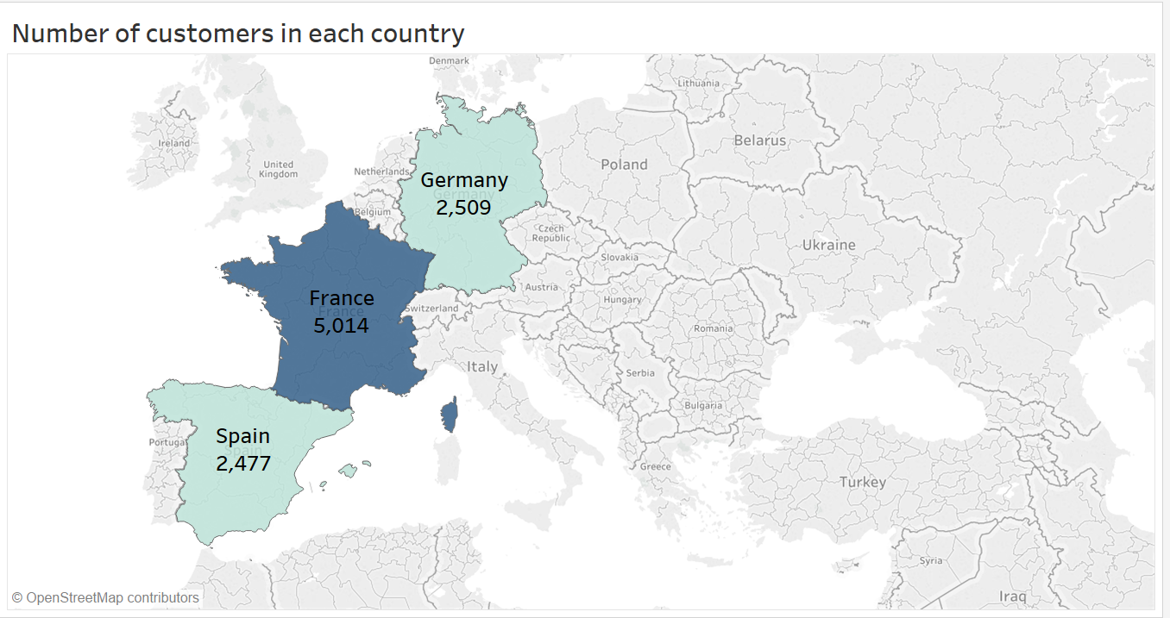
Exploratory Data Analysis
In order to get an initial idea of the data, we created a few visualizations. Some of them are as follows:
Number of customers in each country.
Takeaway: Distribution of customers across the three countries shows that France has the maximum number of customers followed by Germany and Spain.

Slide 8
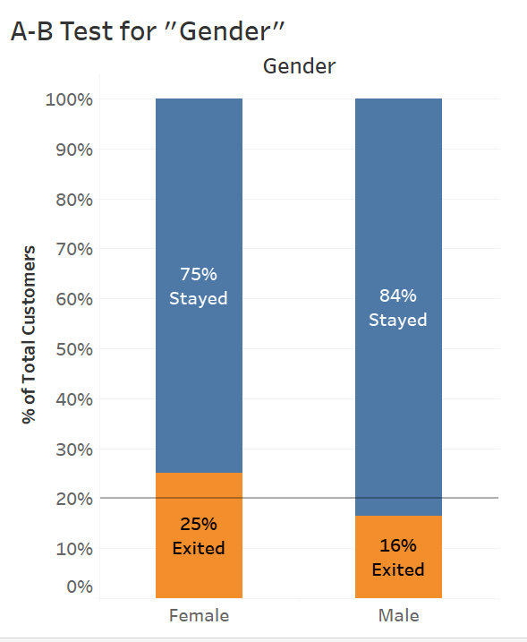
Exploratory Data Analysis
A-B Test for “Gender”
Takeaway: The graph shows that out of the total number of females, 25% exited the bank whereas only 16% of the total number of males exited in comparison.

Slide 9
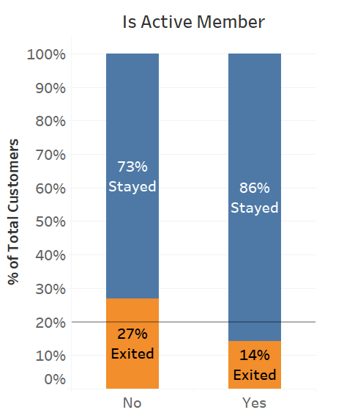
Exploratory Data Analysis
A-B Test for “IsActiveMember”
Takeaway: A-B Test for "IsActiveMember" shows that members who are active (make more number of transactions) are less likely to leave the bank.

Slide 10
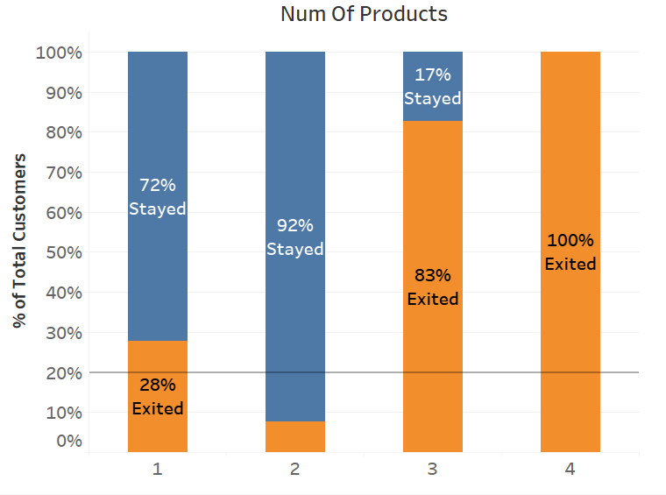
Exploratory Data Analysis
Classification Test for “NumOfProducts”
Takeaway: Classification Test for "NumOfProducts" shows that customers having 3 or 4 products with the bank are more likely to leave. But this result is insignificant since the number of observations are very less for the last 2 bars (data is skewed).

Slide 11
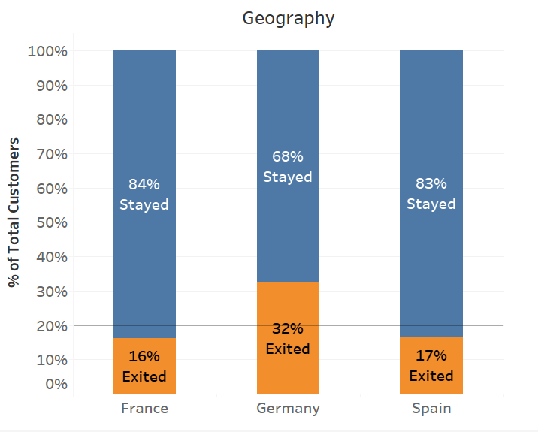
Exploratory Data Analysis
Classification Test for “Geography”
Takeaway: Classification Test for "Geography" shows that customers in Germany are more likely to leave.

Slide 12
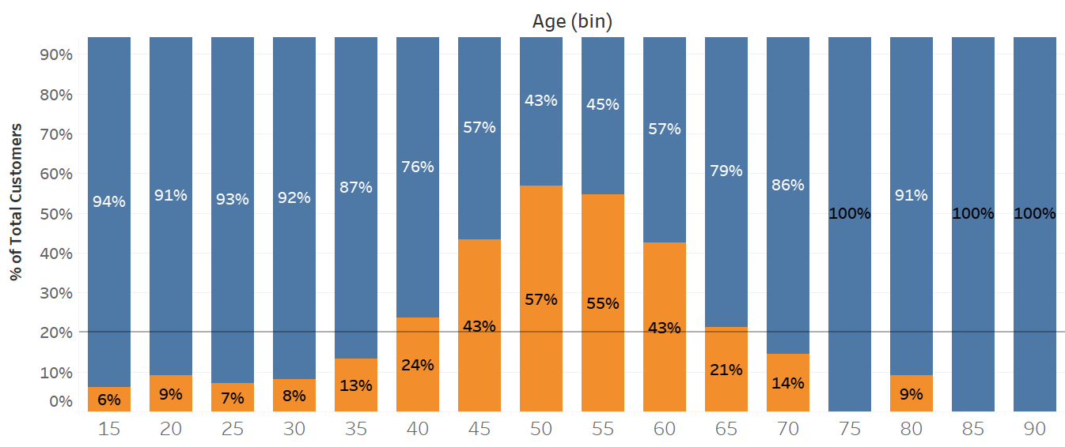
Exploratory Data Analysis
Classification Test for “Age”
Takeaway: Classification Test for “Age” shows that people in the age group of 45 to 60 are more likely to leave the bank.

Slide 13
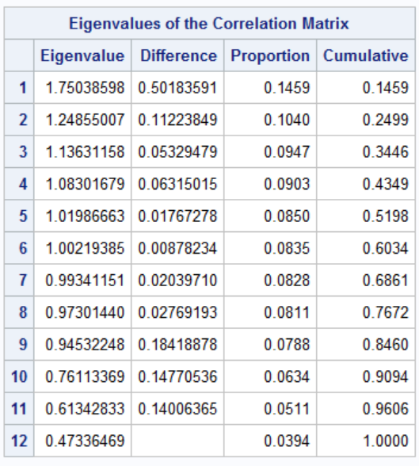
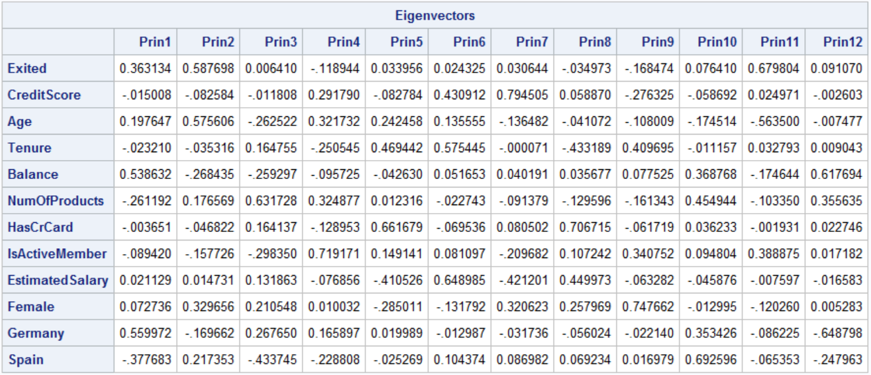
Principal Component Analysis
Principal Component Analysis (PCA) is used to explain the variance-covariance structure of a set of variables through linear combinations. It is often used as a dimensionality-reduction technique.
As can be seen on the next slide, the variables have very low correlation.
The correlation between variables does not bring about a redundancy in the information that can be gathered by the dataset and thus, there is no need to use PCA to transform the original variables to the linear combination of variables which are independent.

Slide 14
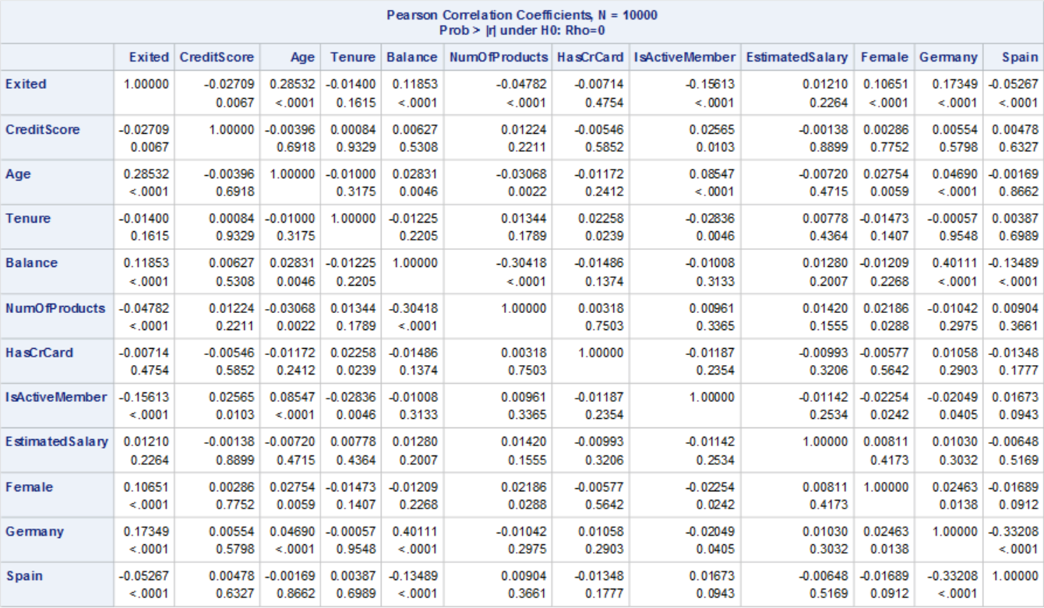
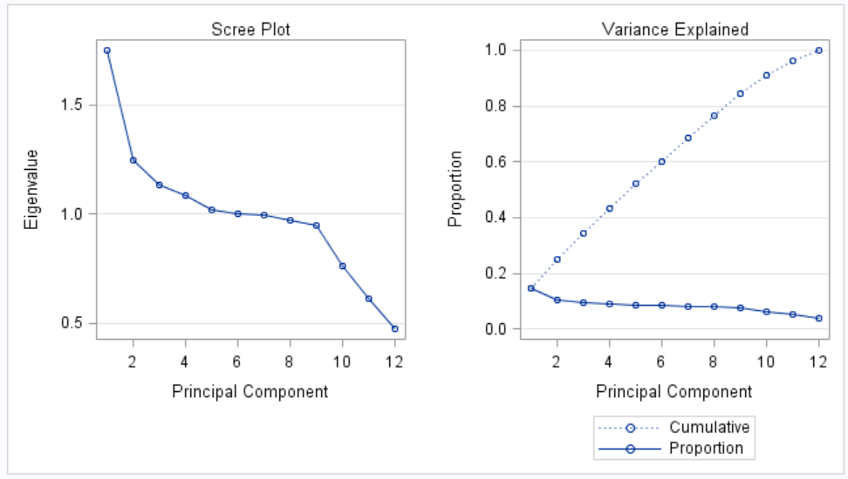
Principal Component Analysis

Slide 15
Data Modeling
We were not really sure if our data had a linear or non-linear decision boundary.
Hence, we first decided to start with logistic regression, and then we tested out a random forest model.
We later compared the performance of the two models using the ROC curves and other parameters.

Slide 16
Logistic Regression
Logistic regression is a linear classifier, which makes it easier to interpret than non-linear models.
At the same time, because it’s a linear model, it has a high bias towards this type of fit, so it may not perform well on non-linear data.
We developed a logistic regression model by splitting our dataset into a training set (10000 records), and test set (1000 records).
We removed the CustomerId, RowNumber and Surname features because they were unique for each observation, and probably didn’t add valuable information to our model.
For our categorical variables “Geography” and “Gender”, we created dummy variables. “Geography” was split into France, Germany and Spain. “Gender” was split into Male and Female.

Slide 17
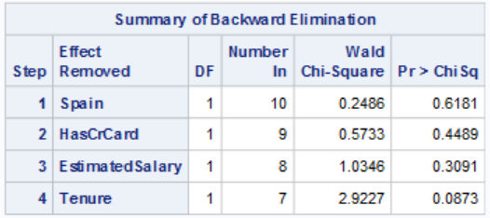
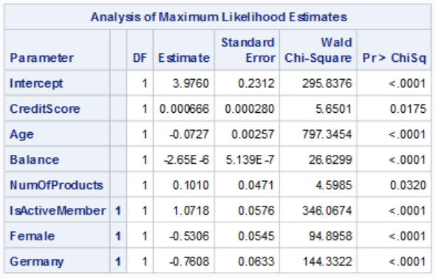
Logistic Regression
While modeling, we considered France and Male as the baseline and hence, they were omitted from analysis.
We used the backward elimination method (MAXR option isn’t available for logistic regression) to model our training data and the results were as follows:
The four variables removed were insignificant at the 5% level. Finally, we were left with only 7 factors which were influential.

Slide 18
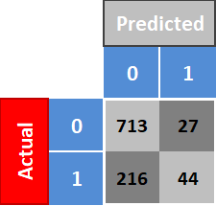
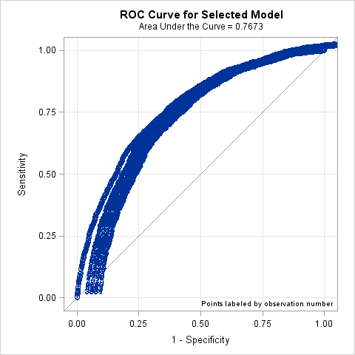
Logistic Regression (Assessment)
Using GRETL, we predicted the probability of customers exiting the bank. Probability of more than 50% was classified as 1 and less than 50% was classified as 0.
The ROC Curve and the confusion matrix for our test data are as below.
The model gave us an accuracy rate of 76% (as can be seen from the area under the curve)

Slide 19
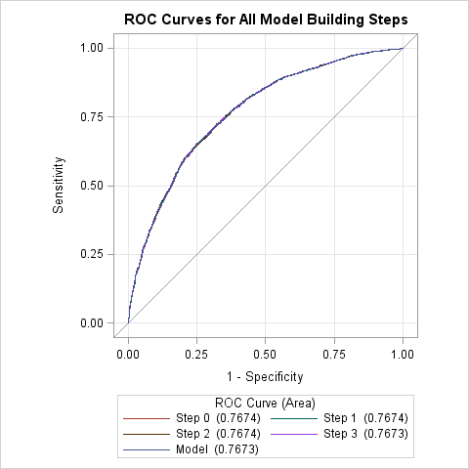
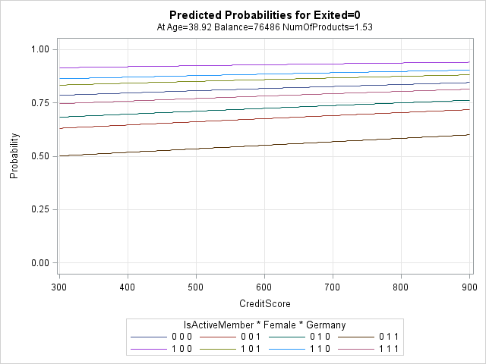
Logistic Regression (Assessment)

Slide 20
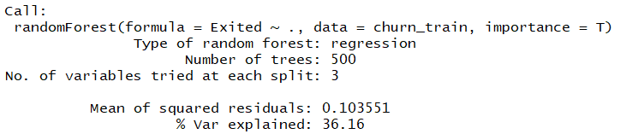
Random Forest
Random forest is another popular classification method.
Unlike logistic regression, random forest is better at fitting non-linear data. It can also work well even if there are correlated features, which can be a problem for interpreting logistic regression.
If random forest performs better than logistic regression, we can probably assume that there was non-linearity in data.
Here, we see that the mean of squared residuals after fitting the model as 0.103551. It’s quite small which means the fit of the model is quite tight.

Slide 21
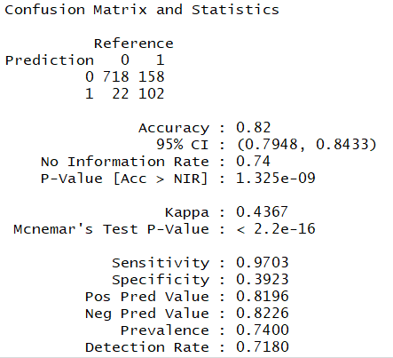
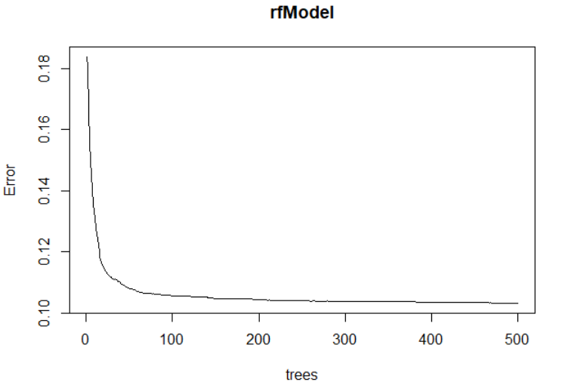
Random Forest (Assessment)
Here, we see the confusion matrix and the random forest error rate.
We see that the accuracy is 82% which is better than logistic regression.
We use this plot to help us determine the number of trees. As the number of trees increases, the OOB (out-of-bag) error rate decreases, and then becomes almost constant. We are not able to decrease the OOB error rate after about 100 to 150 trees.

Slide 22
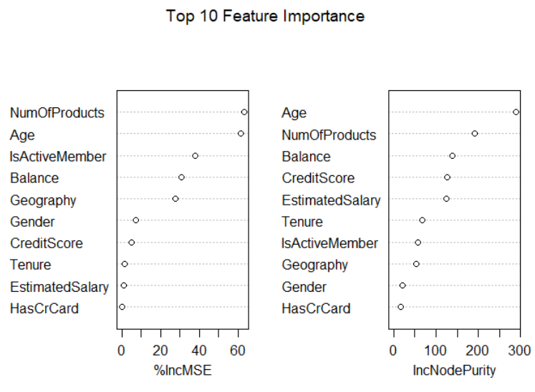
Random Forest (Assessment)
Here, we see the top 10 important features.

Slide 23
Conclusion
We can see that Logistic Regression and Random Forest can be used for customer churn analysis for this particular dataset and Random Forest works a little better.
Throughout the analysis, we have learnt several important things:
Features such as “HasCrCard”, “EstimatedSalary”, and “Spain” (“France”) aren’t really important and have to be removed.
Although, “Tenure” had to be removed, it actually makes sense to keep it in the model since the loyalty of a customer towards a bank usually increases with time.
Females who live in Germany, who are not active, who have only 1 or 2 products with the bank, is in the age group of 40-60, and has a low credit score is most likely to leave the bank.

Slide 24
THANK YOU

